Slide 1
A new Application and research of Transformer in Computer Vision: EfficientViT: Memory Efficient Vision Transformer with Cascaded Group Attention
Maoning Chen
23041352r
EEE Dept.
Notes:
Hello everyone, this is Maoning Chen from EEE Department, Today, I ’m going to introduce A new Application and research of Transformer in Computer Vision filed, the title is EfficientViT: Memory Efficient Vision Transformer with Cascaded Group Attention
This paper is a work conducted by CUHK and Microsoft jointly.

Slide 2
Part 1
Background and introduction
Notes:
First, let’s begin with the background and introduction.

Slide 3
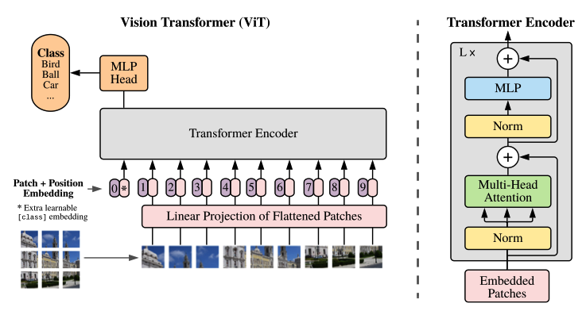
1.1 ViT-Vision transformers
Vision Transformer:
Published in 2021 on ICLR conference.
Image classification tasks
Outperforms CNNs with fewer training resource.
Why Vit
High model capabilities and superior performance.
Extract information globally.
Low computational resource occupation.
Extensible.
Performance can be improved with scale without bottle neck.
Notes:
First，I will introduce Vision Transformer briefly. As a variant of Transformer, Vision transformer was Published in 2021 on ICLR conference.
Unlike original version of Transformer, Vision transformer targets at image classification tasks. Vision transformer outperforms CNNs with fewer training resource in many tasks.
This paper took vision transformer as basis, this is because vision transformers have High model capabilities and superior performance. They can extract information globally. Also, their have Low computational resource occupation.
The performance of Transformers can be improved with scale without bottle neck.

Slide 4
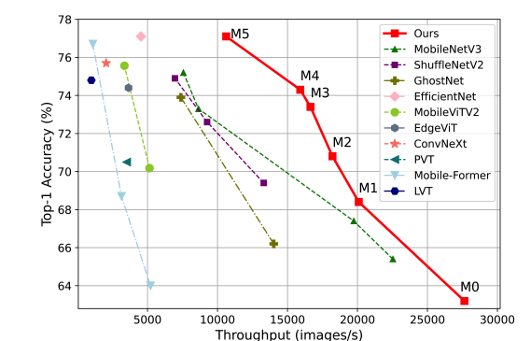
1.2 Research Gap
The constantly improved accuracy comes at the cost of increasing model sizes and computation overhead.
The number of parameters are counted in Billions.
The largescale of such models require powerful hardware, which prevents the models from being deployed to end devices and real-time systems.
Some research has been made to reduce the parameters and FLOPS required by the model.
These metrics do not reflect the actual inference throughput of models
May of them do not show significant wall-clock speed-up.
To solve this problem, this paper seeking to find principles for designing efficient transformer architectures.
The performance of the model in this paper is shown in the right figure.
Notes:
But transformers are not perfect.
In fact, currently, the constantly improved accuracy comes at the cost of increasing model sizes and computation amount.
The number of parameters of such models are counted in Billions. Therefore, the largescale of such models require powerful hardware, which prevents the models from being deployed to end devices and real-time systems.
Some research has been made to reduce the parameters and FLOPS required by the model.
These metrics do not reflect the actual inference throughput of models
Many of them do not show significant reduction in computational time.

Slide 5
Part 2
Problem Analysis and Network Design
Notes:
After knowing the research gaps, we will analyze, design an improved network.

Slide 6
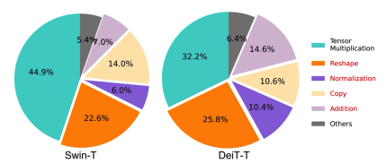
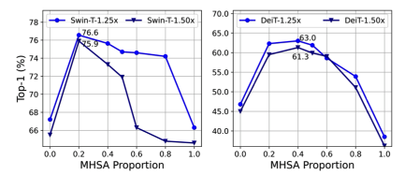
2.1 Observations and Improvement Methods
Here are the observation and improvement ideas on transformers of this paper.
Observation 1:
Time of some operations(such as reshape, copy) are strongly influenced by memory access across different memory units.
Improvement 1: Reduce memory inefficient layers.
There are two parts in Transformer networks: The MHSA layers and FNN layers, MHSA are memory inefficient. Therefore, the model reduces the number of MHSA layers and applied a sandwich layout.
To balance speed and accuracy, the MHSA proportion is tested.
Observation 2:
Attention map is costly can maybe unnecessary, and many heads learn similar projections.
Improvement 2:
This paper feeds each head with only a split of the full feature.
Observation 3:
Some ViT inherit unnecessary parameters from NLP transformers.
Improvement 3:
Redesign channels by Taylor structured pruning.
Notes:
Here are the observations and improvement ideas on transformers of this paper.
The first observation is that the Time of some operations such as reshape and copy, are strongly influenced by memory access.
Thus, we can Reduce memory inefficient layers.
To be more specific, there are two parts in Transformer networks: The MHSA layers and FNN layers, MHSA are memory inefficient. Therefore, the model reduces the number of such layers and applied a sandwich layout. To balance speed and accuracy, the MHSA proportion is tested.
Second，Attention map is costly can maybe unnecessary, and many heads learn similar projections. To solve this problem, this paper feeds each head with only a split of the full feature.
Third，Some ViT inherit unnecessary parameters from NLP transformers. Re

Slide 7
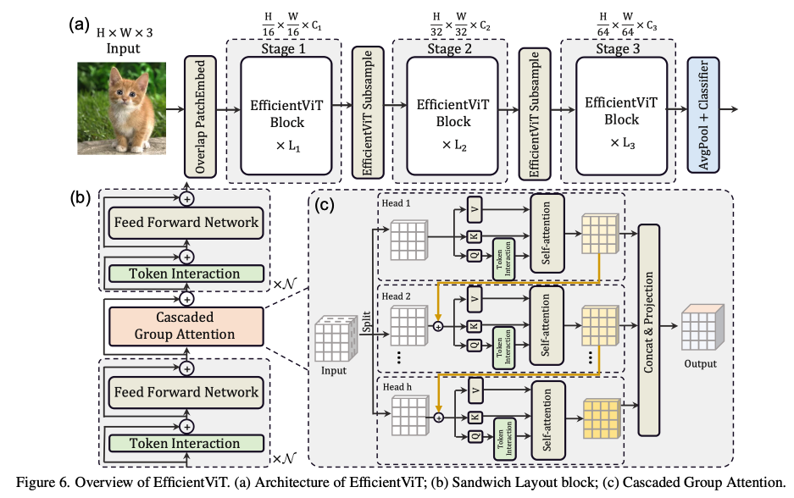


2.2 Network: Efficient Vision Transformer
The structure of the proposed Network is shown in the right figure.
Design 1:
The memory-efficient sandwich block layout is shown as figure b) where a single self-attention layer is between two feed forward layers.
Design 2:
Cascaded Group Attention structure: One attention head is fed with different splits of the full features.
This design can improve the diversity of attention maps and save FLOPS.
This design can improve the network depth.
Design 3:
Reallocate the parameters in the network by ex-panding the channel width of critical modules while shrinking the unimportant ones.
Notes:
The structure of the proposed Network is shown in the right figure.
To solve the first problem, the memory-efficient sandwich block layout is applied.
This layout is shown as figure b) where a single self-attention layer is between two feed forward layers.
To solve the second problem, which some attention maps may be costly and unnecessary this paper applied a cascaded Group Attention structure: One attention head is fed with different splits of the full features.
This design can improve the diversity of attention maps and save FLOPS as well as the network depth.
Finally, this paper reallocate the parameters in the network by expanding the channel width of critical modules while shrinking the unimportant ones.

Slide 8
Part 3
Experiments, results and perspectives
Notes:
After the network design, some experiments are done.

Slide 9
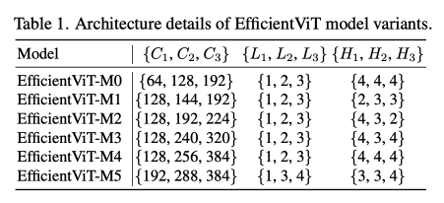
3.1 Dataset Design and training
Dataset:
ImageNet-1K
Training environment:
PyTorch 1.11.0, Timm 0.5.4 8, Nvidia V100 GPUs
Trianing Method:
From scratch for 300 epochs
Batch size 2,048.
The input images are resized and randomly cropped into 224×224.
The initial learning rate is 1×10−3 with weight decay of 2.5×10−2.
Data augmentation strategies including Mix-up, auto-augmentation , and random erasing are applied.
The model was further runed on CPU and other platforms.
Another 300 epochs are applied to finetune the network to conduct downstream image classification.
Notes:
The paper use ImangeNet-1k to train the model.
The network was trained from scratch for 300 epochs.
The training parameters are shown as follows.
The model was further runed on CPU and other platforms.
Another 300 epochs are applied to fine tune the network to conduct downstream image classification which means a transfer learning was conducted.
Six models with different sizes are tested (From M0-M5)

Slide 10
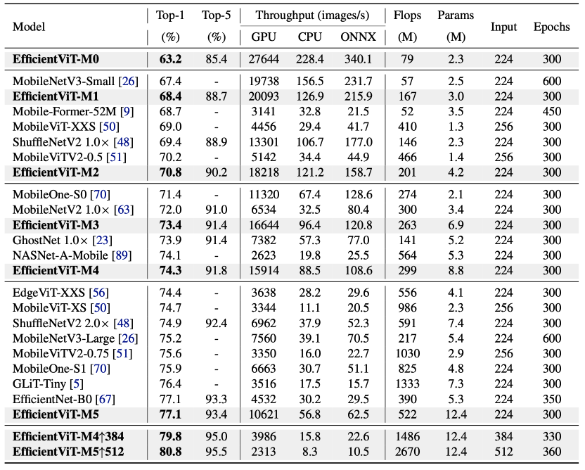
3.2 Performance Comparison
Comparing to CNNs:
EfficientVit M3 VS Mobile Nets V2
1.4% better top-1 accuracy
2.5× faster on GPU and 3.0× faster on Intel CPU.
EfficientVit M5 VS MobileNetV3-Large:
1.9% higher accuracy
40.5% faster on GPU and 45.2% faster on CPU
Comparisons with efficient ViTs
Comparing to ViTs:
EfficientViT-M4 VS EdgeViT-XXS
Similar accuracy
4.4× faster on GPUS and 3.0× faster on CPUS
Transfer learning:
Largest Throughput
Highest accuracy in CIFAR-10 and other three datasets.
Best performance in objective detections.
Ablation studies are conducted on the sandwich layout block,
cascaded group attention, and cascaded group attention blocks and other components.
Notes:
When comparing to CNNs, EffivientVit M3 network have 1.4% better top-1 accuracy than Mobile Nets V2 with running at 2.5× on V100 GPU and and 3.0× faster speed on Intel CPU
When comparing to other Vits,
EfficientViT-M4 have Similar accuracy with EdgeViT-XXS with 4.4× faster on GPUS and 3.0× faster on CPUS
On transfer learning tasks, EffivientVit have Largest Throughput. It also achieves highest accuracy in CIFAR-10 and other three datasets.
It also have a best performance in objective detections.

Slide 11
3.3 Future Perspective
More experiments shall be conducted on Mobile platforms to evaluate the effectiveness of this model.
In future work, the model size can be further reduced.
The similar research can be conducted on other transformers to accelerate other tasks.
Notes:
In future,
More experiments shall be conducted on Mobile platforms to evaluate the effectiveness of this model.
In future work, the model size can be further reduced.
The similar research can be conducted on other transformers to accelerate other tasks.

Slide 12
References
[1] Liu, X., Peng, H., Zheng, N., Yang, Y., Hu, H., & Yuan, Y. (2023). Efficientvit: Memory efficient vision transformer with cascaded group attention. In Proceedings of the IEEE/CVF Conference on Computer Vision and Pattern Recognition (pp. 14420-14430).
[2] Alexey Dosovitskiy, Lucas Beyer, Alexander Kolesnikov, Dirk Weissenborn, Xiaohua Zhai, Thomas Unterthiner, Mostafa Dehghani, Matthias Minderer, Georg Heigold, Syl-vain Gelly, et al. An image is worth 16x16 words: Trans-formers for image recognition at scale. ICLR, 2021. 1, 2, 3, 7, 8
Notes:
(Here are my references)

Slide 13
Thanks!
Notes:
That’s all for my presentation, thanks a lot for your listening!
Head 和各种参数 QWE 要懂技术细节，仔细看教程和PPT！！！
Taylor structured pruning:
Different M1M2M3M4M5 networks:

